Slide 1
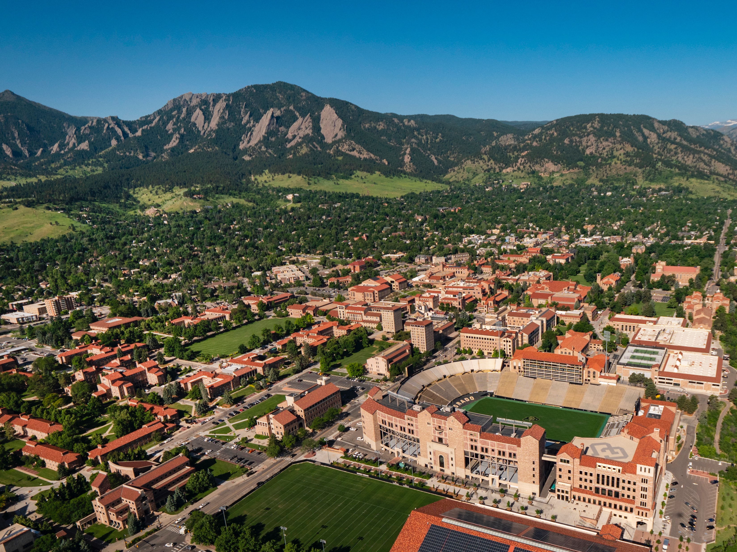

Slide 2
Content Optimization with Multi-Arm Bandits & How to Title Presentations Guest Talk CSCI 4830 Special Topics in Computer Science Data Driven Design 2021-03-18 Brad Weiner Director of Data Science CU Boulder

Slide 3
Me
Call me Brad
Director of Data Science at CU Boulder
I use institutional data to inform decision-making
Excited to chat with you today and beyond
First time teaching on Zoom, if you have questions, please just interrupt.

Slide 4
Today’s Discussion
Quick Introduction
Apartment Hunting in Springfield
Learning vs. Earning in User Experience
Frequentists and Bayesians
Questions
Open Ended Data Science Questions

Slide 5
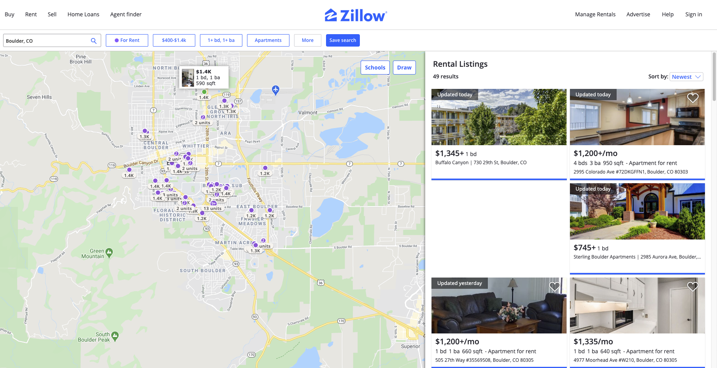
Finding an Apartment in Springfield

Slide 6








Constraints
Notes:
Question mark is just some mysterious thing that you’ve have to see to understand

Slide 7


Slide 8
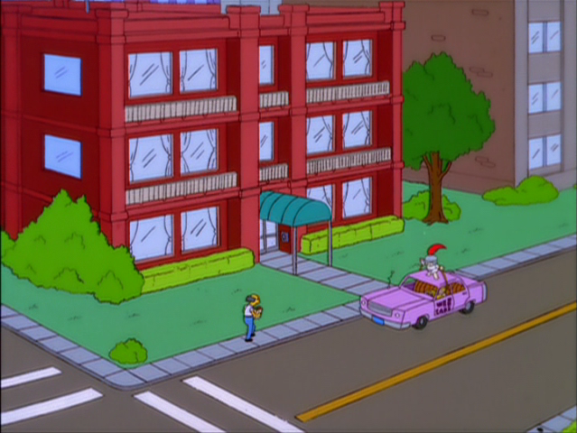

Slide 9


Slide 10
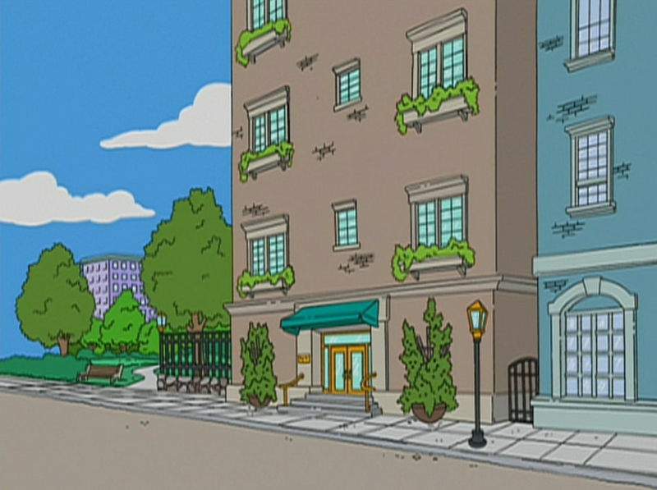

Slide 11

Question: When Do You Stop Looking and Put Down a Deposit?

Slide 12

The challenge:
If you deposit too early, you may miss out on a better apartment
If you keep looking, you’ll never find an apartment

Slide 13
Some Knowledge Here:
This is a well-known computer science problem called the explore-exploit tradeoff
Computers can scan through nearly limitless choices. How do we maximize the expected value from a selection?

Slide 14
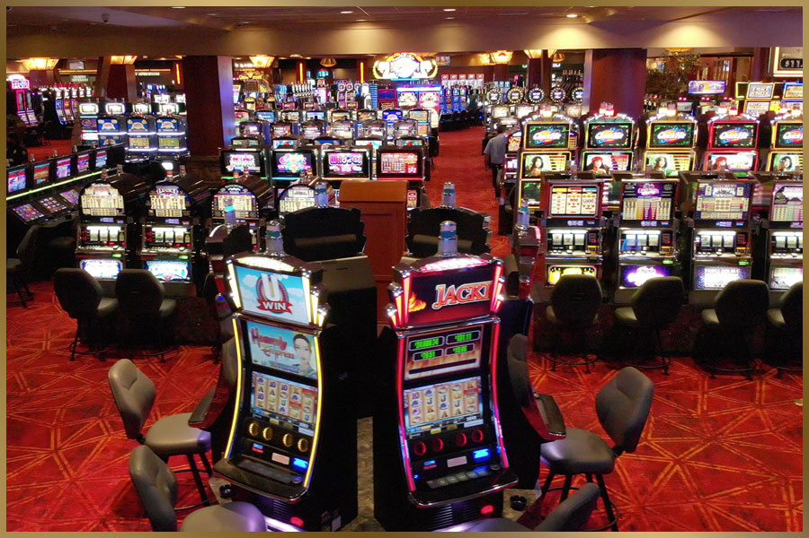
Multi-Arm Bandits (MAB)
Multi-arm bandits are algorithms that seek to maximize an expected payout
They are intended for the most rapid move toward the “exploit” decision
There are a variety of strategies for algorithms to switch from explore to exploit

Slide 15
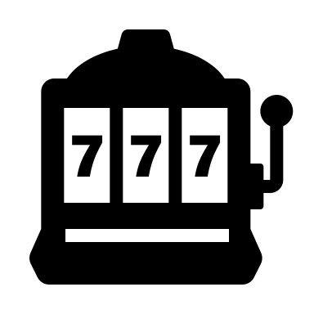

Which machine has highest expected reward?

Slide 19

Try again, just to make sure
THIS IS $EPSILON\left(∈\right)$

Slide 22
Let’s exploit that knowledge and win some money!

Slide 23
SIMULATION
Source Code: https://gist.github.com/robinvanemden/30969b48a44c2742a18ae14861793741#file-epsilon_greedy_animation-r

Slide 25
Are there other ways I could explore then exploit?

Slide 26
Multi-Arm Bandit Solutions
Changes to Explore/Exploit Ratio (Epsilon)
Do all exploring first
Gradually reduce the explore (Epsilon) rate over time
Changes to Bandit Selection
Contextual bandits that choose the “correct” machine based on gambler’s information
Different Algorithmic Approach
Thompson Sampling (Bayesian)

Slide 27
An Oversimplified Description of Statistical Approaches
Frequentist
Assumes that with a large enough sample size, the point estimate (usually mean) gives the best guess at the whole population
Bayesian
Assumes that the “right” answer is actually a range of probabilities from a distribution which can change and be updated

Slide 28
SIMULATION
Source Code: https://gist.github.com/robinvanemden/30969b48a44c2742a18ae14861793741#file-thompson_sampling_animation-r
Notes:
A Thompson Sampling bandit policy works by maintaining a prior distribution on the the mean rewards of its arms. In this, it follows a beta-binomial model with parameters alpha and beta, sampling values for each arm based on their prior distributions, then choosing the arm with the highest sampled value. When an arm is pulled and its binary reward is received, the policy modifies the prior distribution of that particular arm accordingly. This procedure is repeated for the next arm pull.

Slide 29
Experiments in Web Design

Slide 30





Which content has highest expected engagement?

Slide 31
A/B Split Test vs. Multi-Arm Bandit
Develop a randomized statistical test to understand which among multiple options is “significantly” better
Deploy an algorithm that programmatically selects the current “winner”
Pro: You get a definitive answer and your organization learns
Con: It takes time and requires a robust sample size
Pro: Your users are getting the benefit of the current, "best" version and the highest engagement rate
Con: The results might not provide a clear organizational answer

Slide 32
Key Takeaways
Randomized experimentation is critical. You should deploy as many useful experiments as your organization can effectively absorb
There are multiple approaches, and the main question is “Are you trying to understand or to maximize?”
Understanding the mechanics of these methods is helpful, but you don’t need to be a statistician to use Google or Optimizely

Slide 33

Questions

Slide 34
Data Science Questions

Slide 35
Sources
Zillow
Simpsons images are protected by copyright and used here under fair use/educational guidelines
Interactive Bandits:
https://pavlov.tech/2019/03/02/animated-multi-armed-bandit-policies/
Original R Code for Interactive Bandits:
https://gist.github.com/robinvanemden/30969b48a44c2742a18ae14861793741
Updated R Code for Interactive Bandits:
https://gist.github.com/bradweiner/96593a8e7a34c03c0a92db33fdc64f75
Algorithms to Live By
Christian, B., & Griffiths, T. (2016). Algorithms to live by: The computer science of human decisions.
* Note that the interactive bandits in lecture were slightly repurposed, but otherwise copied from Github gist from Robin van Emden

Slide 36
Stable Location
This presentation can be found at:
https://bradweiner.info/files/mab_presentation.pdf
Bandit Simulations:
https://bradweiner.github.io/multi_arm_bandit_presentation/
Github Repo:
https://github.com/bradweiner/multi_arm_bandit_presentation

Slide 37



Contact Information
brad.weiner@colorado.edu
@brad_weiner
https://github.com/bradweiner

